Slide 1
TERRAFORM NGINX LOAD BALANCER
Bachtiar Juli Anandi
E41231498

Slide 2
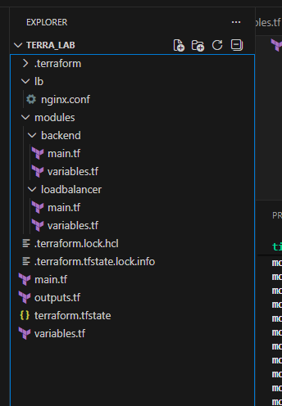
Struktur Folder

Slide 3
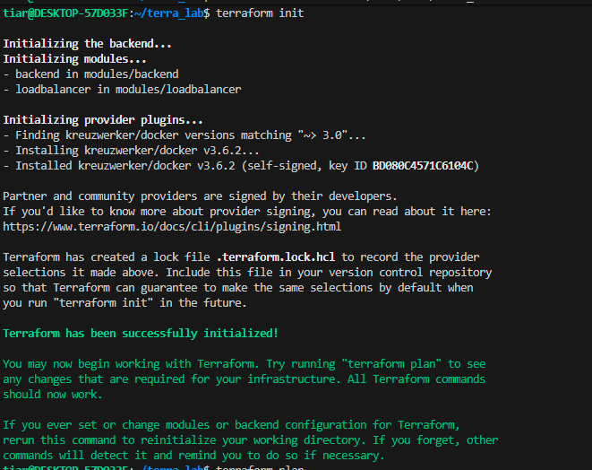
Terraform Init

Slide 4
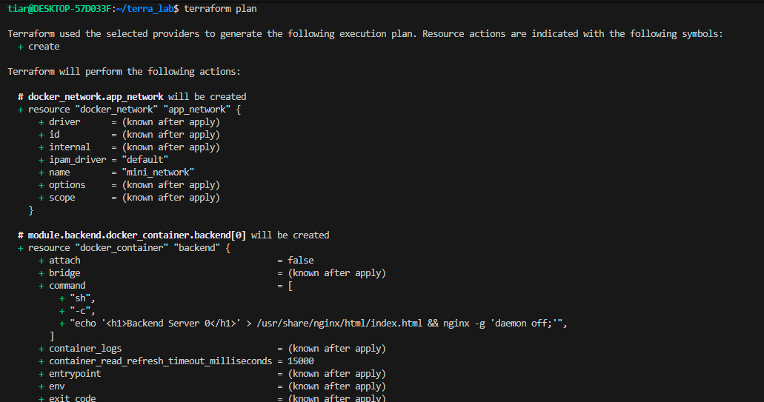
Terraform Plan

Slide 5
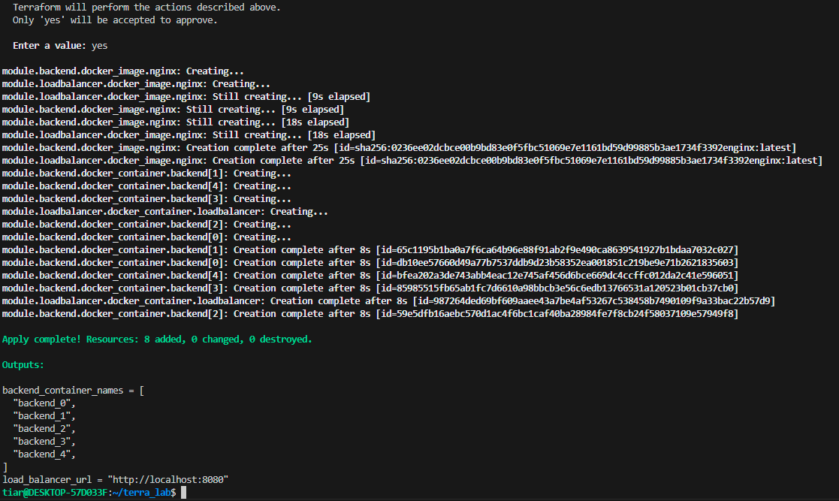
Terraform Apply

Slide 6
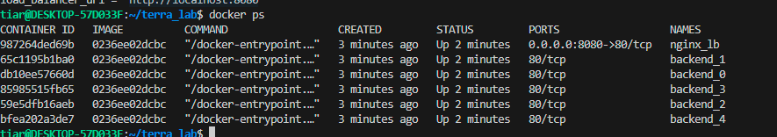
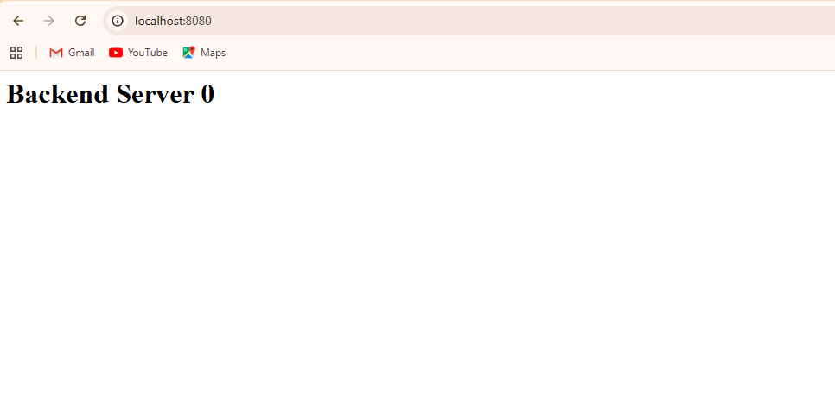
Hasil

